Slide 1
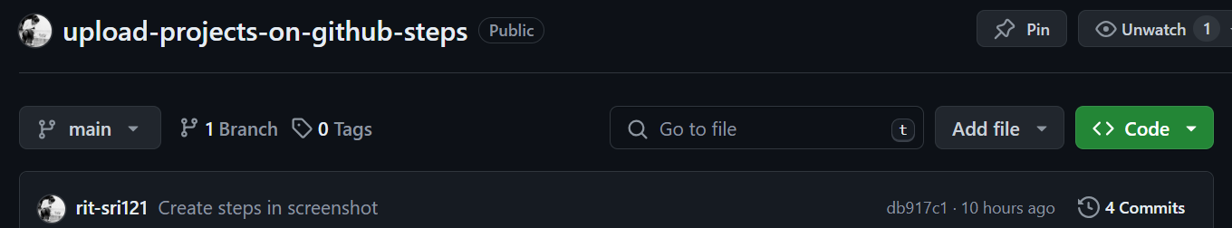
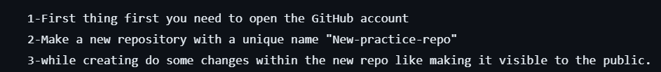
First step- create a new repo in Github
Make sure to make it public while creating.
First 3 steps completed.

Slide 2
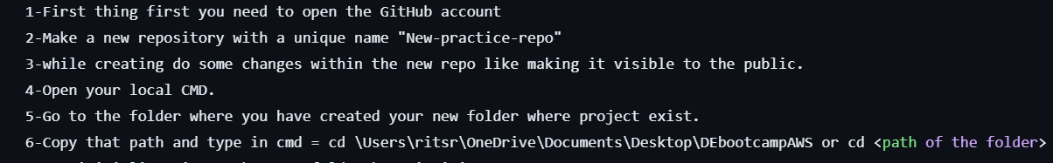
First 6 steps are completed.

Slide 3
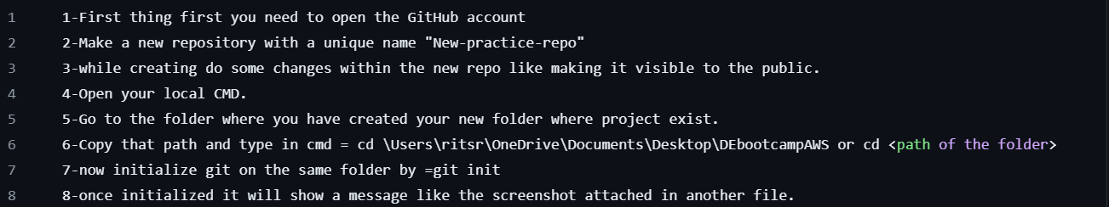
Create a folder and move to that folder.
Then run git initializer in cmd.
8 steps are completed.

Slide 4
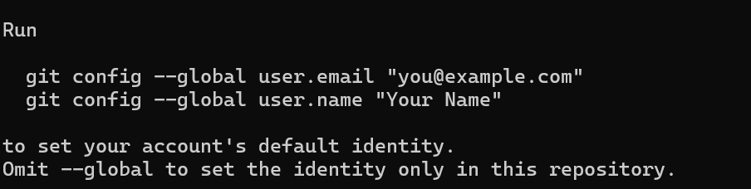
Following step 9 below-
Once you add any changes and do commit you’ll be pop up with this error.
Now you have to confirm your identification.

Slide 5
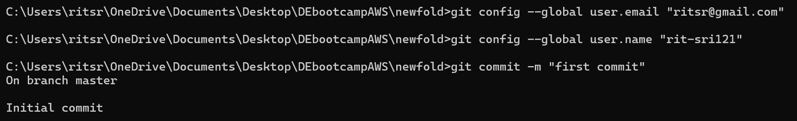
After adding author try commit again.
Now add your remote branch in which you want to add the route.
Hence we pushed the changes and thus projects got uploaded in github hasslefree

Slide 6
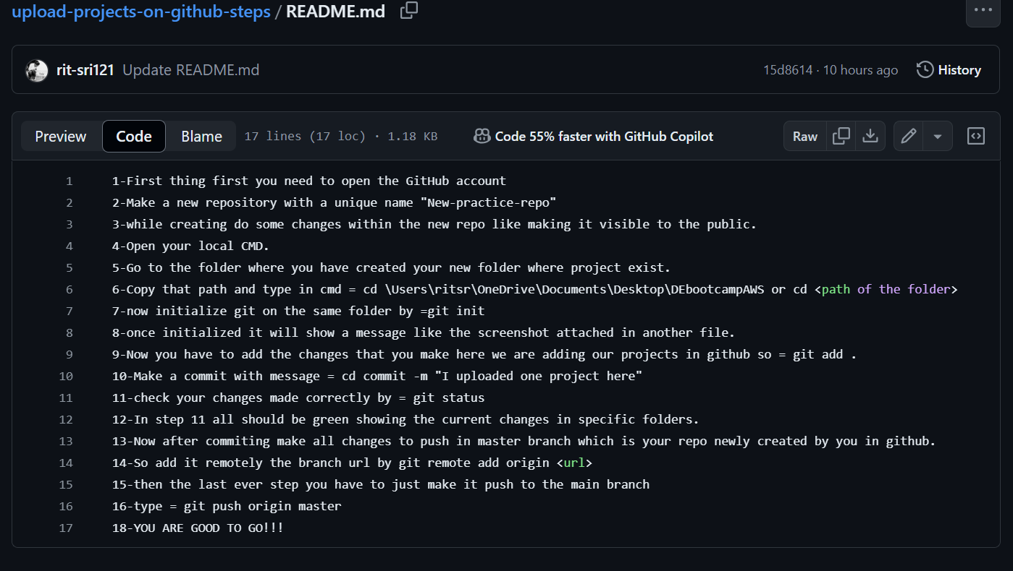
Hence all steps are completed at this stage.
Enjoy your learning!!

